Slide 1
Account Receivables
Notes:
This In-house course was developed to meet the needs of SAP R/3 Consultants working at Capgemini. This course is designed to present a high level view of XXXX and to provide the Consultants with basic information about how to use this Functionality.
More in-depth courses have been developed to train Consultants in specific areas discussed during this course.
Your comments at the conclusion of this training session are appreciated and will help us better tailor future courses to meet your training needs.

Slide 2
Over view
Customer account group
Customer master data
Posting of Invoices and Cash Receipts

Slide 3
Customer Account Group
.
The status of the fields in the master record.
Whether the account is for one – time customer or General customer.
Which fields in the customer master should be optional, required, display or suppressed.
The number range of the accounts.
Status
C
O
N
T
R
O
L
S
Customer
Account Grp
Partner Schema
Field Selection
Number Range
Notes:
The account group controls:
When you create a master record for a business partner, you must enter an account group. The group determines:
Which screens and fields are necessary for entering master data
How master record numbers are assigned (externally by you or internally by the system) and the number range from which they are assigned
Whether the business partner is a one-time customer or one-time vendor

Slide 4
Customer Account Group
General Customer or one- time customer
Account group determines...
Field selection
Type of number
assignment
Number
assignment interval
Notes:
An account group defines the control functions for customer master record maintenance.
Every customer master is managed under an account group.

Slide 5
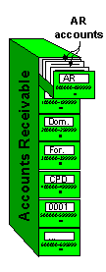
Account group
Grouping of similar accounts in ranges. It ensures that only the relevant screens and fields are displayed and ready for input for each of the customer’s different partner functions. You maintain the account groups in Customizing (IMG), or copy the defaulted account groups.
Account Groups controls:
The number ranges of the Accounts
The status of the fields in the Master record
(If fields are mandatory, suppressed, changeable)
Authorization, who is allowed to Create, Change and
display Master Records
If the Account is a One Time Customer

Slide 6
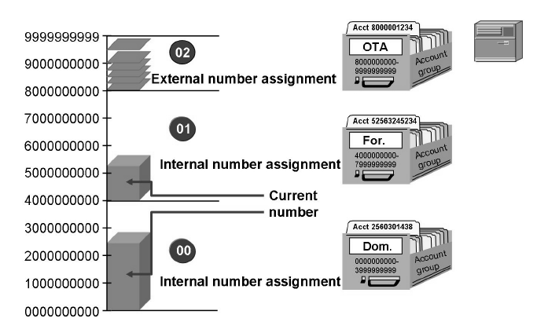
Number ranges
The range of possible account numbers is divided into smaller number ranges. Number ranges must not overlap. For each number range you can define whether the number assignment is internal or external.
Internal numbers are assigned by the system, whereas external numbers are entered by the user who creates the record. External numbers may be alphanumeric.
Each number range can be assigned to one or more account groups.

Slide 7
Number ranges
Internal Number Range | External Number Range
System will automatically allocate the number range within the given range, sequentially. | User has to assign externally the number, as required.
Alpha Numeric number is not possible. | Alpha Numeric number is possible.
System will give next number. | User has to select the number by checking the existing records.

Slide 8
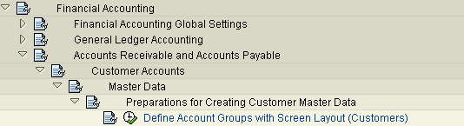
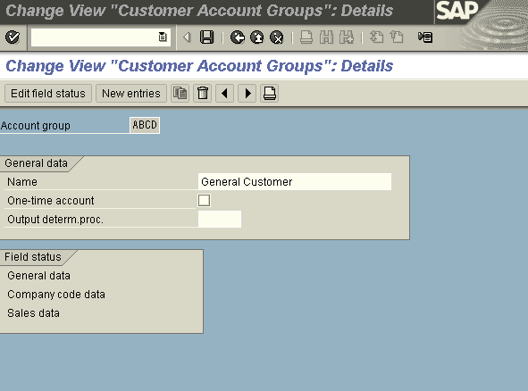
Customer Account Group
Double click General data and Follow…..steps
Field Status Group: For each activity, you can define the status of fields separately in the individual areas of a master record in the same manner as account groups:
1. General data area:
2. Company code area : These settings affect all company codes.
3. Sales area: These settings affect all sales organizations.

Slide 9
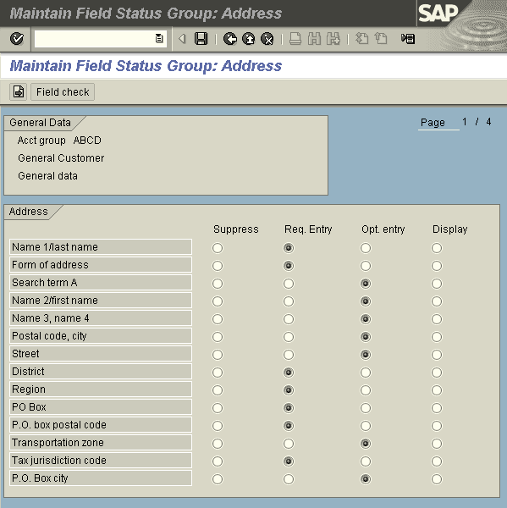
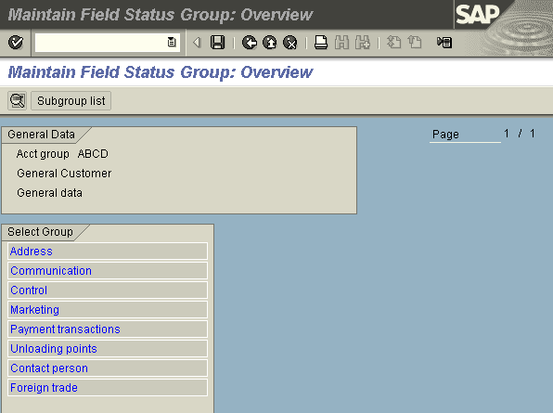
Customer Account Group
First screen displays general data: Which contains address information of customer. Second screen displays which fields are required , optional, suppressed.

Slide 10
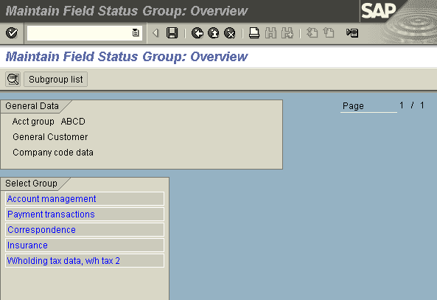
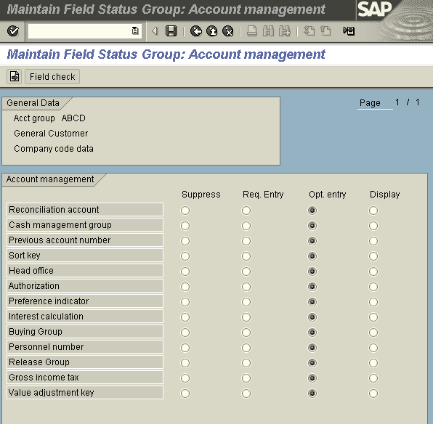
Customer Account Group
Company code data
The company code data contains Account Management, Payment transactions,
Correspondence and withholding tax.

Slide 11
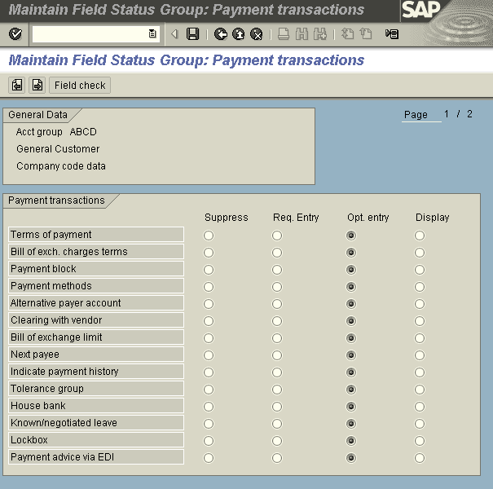
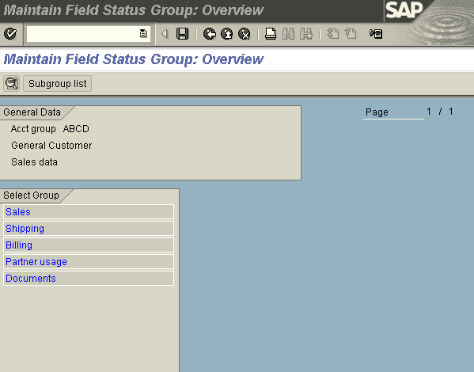
Customer Account Group

Slide 12

Customer Master Data
The Customer Master includes all data necessary for processing business transactions and corresponding with customer.
Information is shared between the accounting and sales departments.
Data is grouped into three categories:
General data
Company code data
Sales data
Customer Master Data
General data
Company code data
Sales Org data

Slide 13
Customer Master Data
The accounting department uses some data which remains unchanged for long periods of time and which is often referred to by other data. This data is called master data.
Customer Master Data
IN FI, master data is includes general ledger and sub ledger accounts , as well as bank master records.
The master record contains data that controls how business transactions are recorded and processed by the system. It also includes all the information about a customer that you need to be able to conduct business with him
The Accounts Receivable application component records and manages accounting data for all customers. It is also an integral part of the sales system:

Slide 14
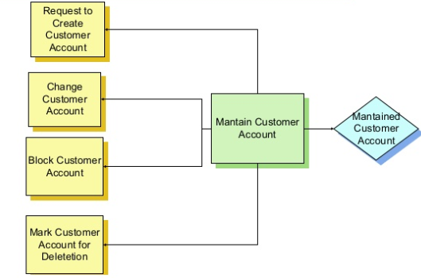
Master Data Activity Flow

Slide 15
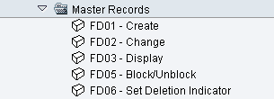
Customer Master Data

Slide 16
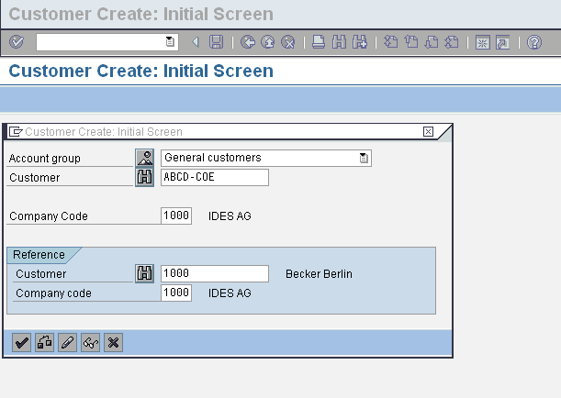
Customer Master Data

Slide 17
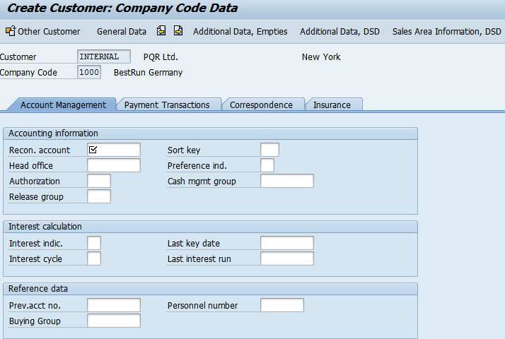
Customer Master Data

Slide 18
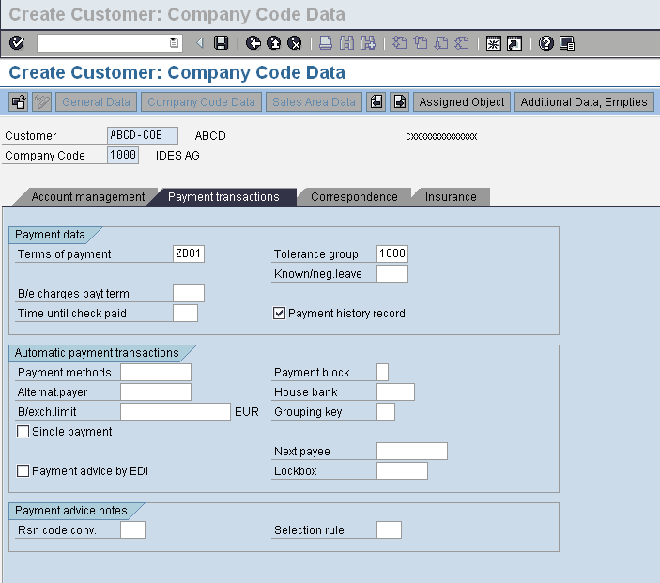
Customer Master Data

Slide 19
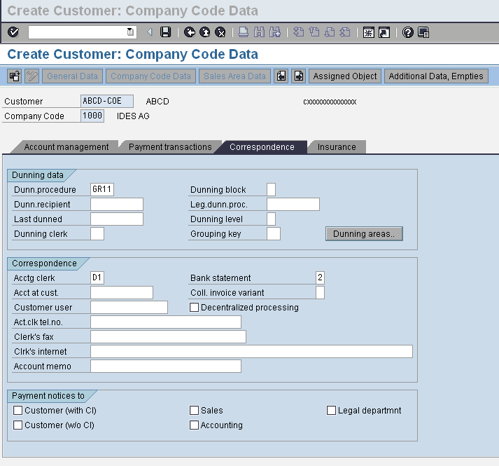
Customer Master Data

Slide 20
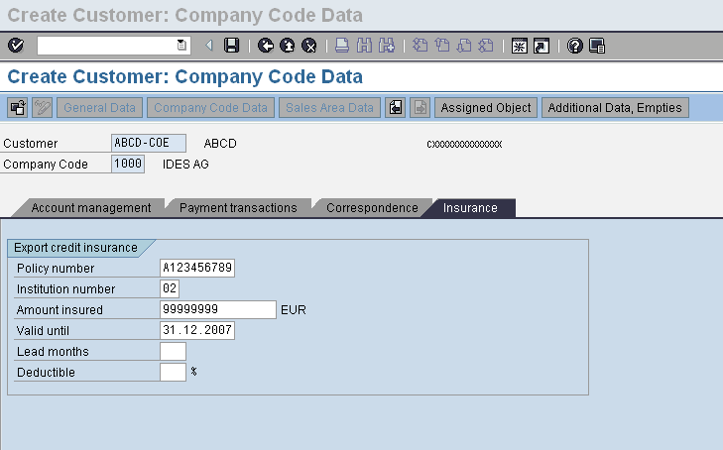
Customer Master Data:

Slide 21

Master data

Slide 22
Customer Invoice Posting
You enter the general data for the posting document on the screen in the document header, for example, invoice date, posting date, reference, document header text, and so on. For entering invoice and credit memos received, you can define a document type for each transaction, which then appears as a general default value. SAP has provided standard document types for these transactions. However, we can configure and use different type of documents to meet special requirement of client.
You can overwrite this proposed document type at any time as long as the document type field is ready for input during document entry.
If you do not define a document type, the system proposes standard document types; for example, DR for posting customer invoices, DZ for receipts from customer.

Slide 23
Enjoy Posting Screen: Additional Line Items
Enter the additional line items for the document in the table in the bottom section of the screen.
The account name appears once you have made and confirmed your entries.
You can select different fields or columns and change the size and sequence of the columns and fields.
You can also copy line items.
At the top of the screen, you can select from park, post or hold, to complete the document entry transaction once the balance is zero.

Slide 24
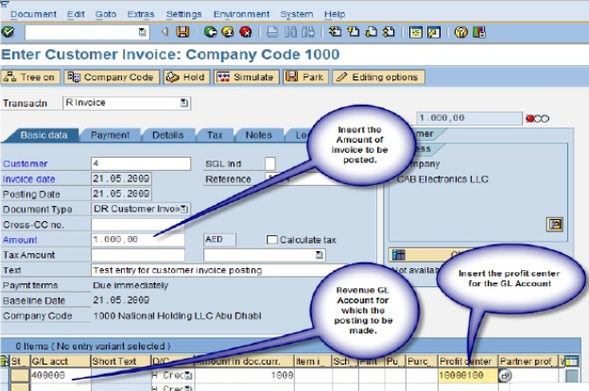
Post Customer Invoice Transaction Code FB70

Slide 25
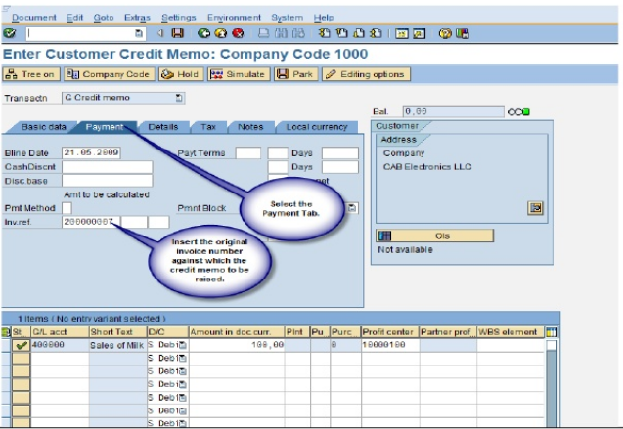
Post Customer Credit Memo Transaction Code FB75

Slide 26
Process for Cash Receipts
cash receipt is recognized when an entity receives cash from any external source, such as a customer, an investor, or a bank. Typically, this cash is recognized when money is received from a customer to offset the AR balances generated when the sale transaction occurred.
.

Slide 27
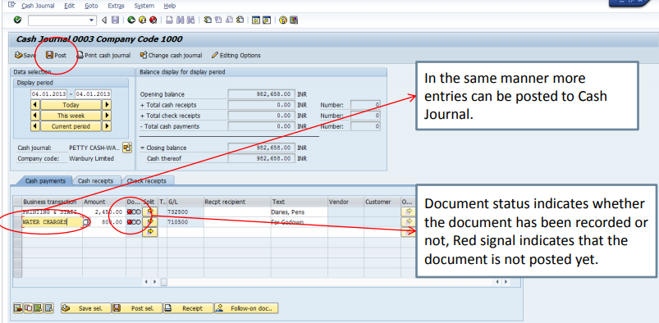
Cash Journal Posting
Notes:
Cash Journal in SAP represents a Petty Cash tin and, as such works, in the same way. It is not possible for Petty Cash to go “overdrawn” and so before we can make any Payment transactions we have to fund the Petty Cash tin. This can be either a receipt from the bank, a receipt from a cash sale or a receipt from a customer.

Slide 28
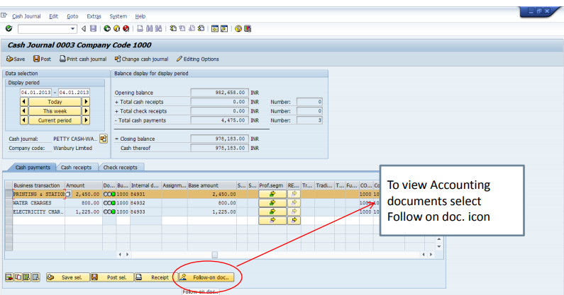

Slide 29
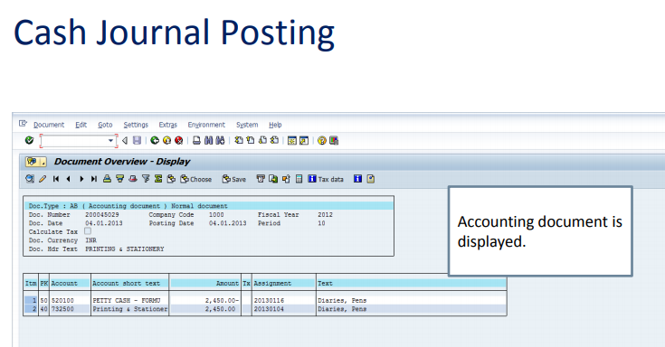
Notes:
Cash Receipts received from Customers work in a similar way; they are simply posted against the Customer as a Receipt on Account and need to be subsequently cleared using F-32

Slide 30
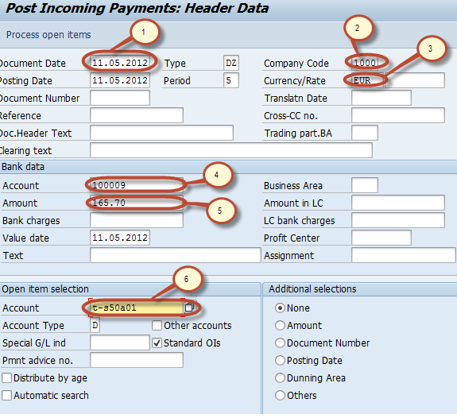
Customer Incoming Cash/ Bank Payments
Notes:
Step 1) Enter the transaction code F-28 in the Command Field
Step 2) In the next screen, Enter the following data
Enter the Document Date
Enter the Company Code
Enter the Payment Currency
Enter the Cash/Bank Account the Payment is to be posted
Enter the Payment Amount
Enter the Customer Id of the customer making the Payment

Slide 31


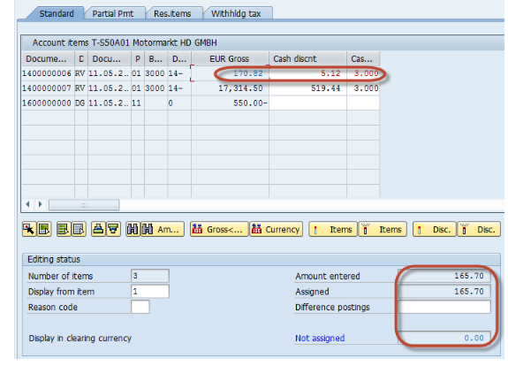

Notes:
Step 3) Press the Process Open Items Button to display the list of Pending Invoice
Step 4) Assign the Payment Amount to Appropriate Invoice so as to balance the Payment with the Invoice Amount
Step 5) Press Post from the Standard Toolbar to post the Incoming Payment
Step 6) Check for the Status bar for the Document number to be generated

